Slide 1


Unit 1
HHFA questionnaire content
Notes:
Welcome to Unit 1 of Module 2.

Slide 2
By the end of this unit, you will be able to:
describe how the questionnaire content is organized
list the categories of information collected in the service readiness sections
Notes:
By the end of this unit, you will be able to:
describe how the questionnaire content is organized;
list the categories of information collected in the service readiness sections.

Slide 3

Questionnaire content
Combined core questionnaire
Modules:
Availability
Readiness
Management and finance
Sections:
31
Notes:
We will use the HHFA combined core questionnaire to demonstrate the questionnaire content.​
The combined core questionnaire contains the core questions from the Availability, Readiness, and Management and finance modules. ​
The questionnaire is organized into 31 sections.

Slide 4
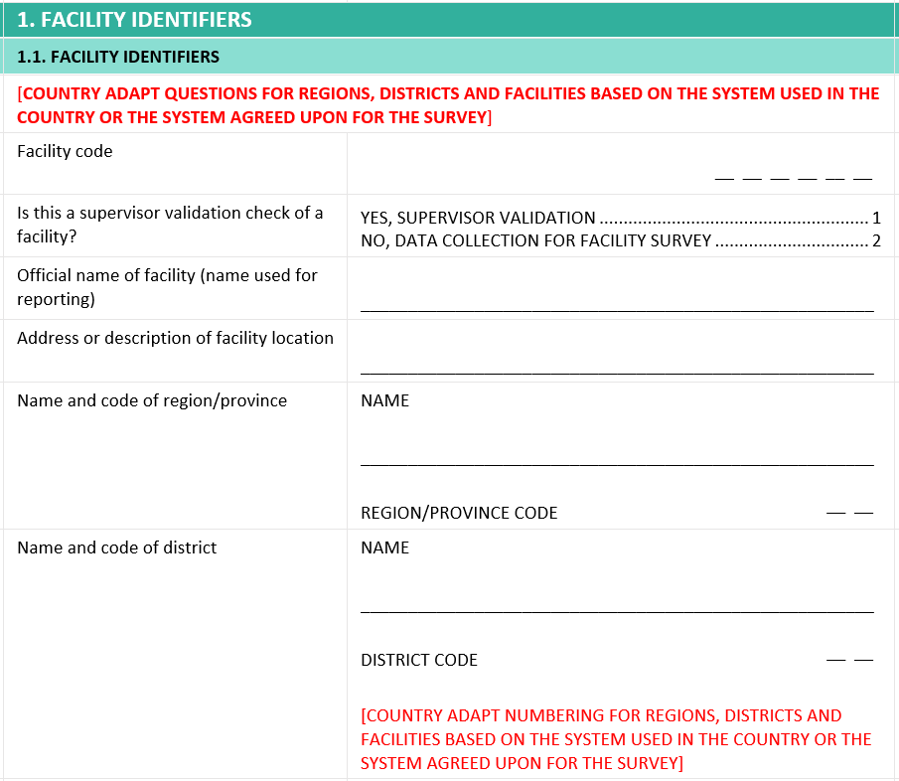
Questionnaire content: Sections
Section 1
Facility identifiers:
facility name
region/district
managing authority
GPS coordinates
Notes:
Section 1 contains essential information for identifying the facility, such as:​
the facility name, ​
the region and district in which it is located, ​
the managing authority (for example, ministry of health, non-governmental organization, or private sector), and​
the GPS coordinates.

Slide 5
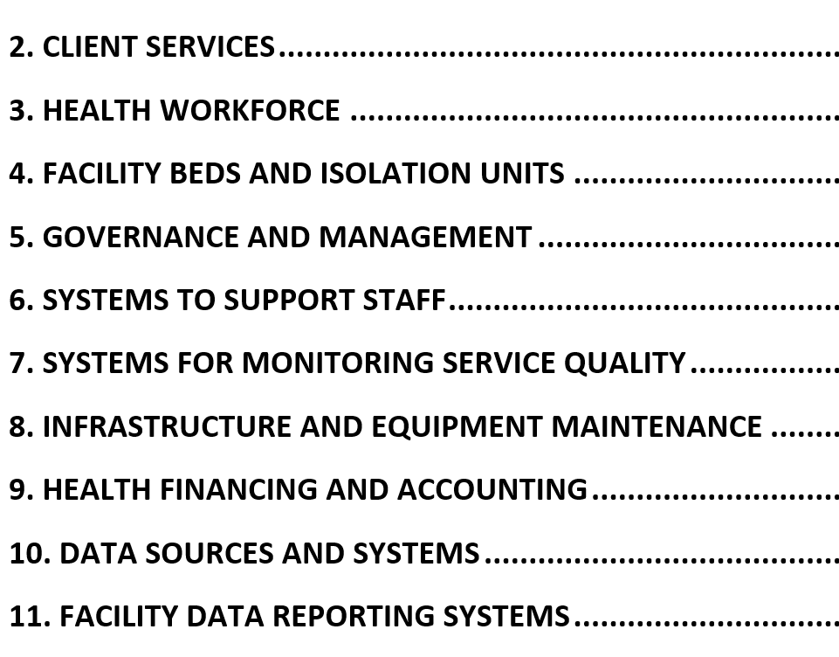
Questionnaire content: Sections
Sections 2–11
Availability
Management and finance
Notes:
Sections 2 to 11 contain questions that belong mainly to the modules of Availability and Management and finance.​
​
For example:​
​
Section 3 – ‘Health workforce’ – and Section 4 – ‘Facility beds and isolation units’ - contain questions related to the Availability module;​
Sections 5 to 11 mainly relate to the Management and finance module, such as:​
Section 5 on ‘Governance and management’;​
Section 9 on ‘Health financing and accounting’; ​or
Section 11 on ‘Facility data reporting systems’.

Slide 6
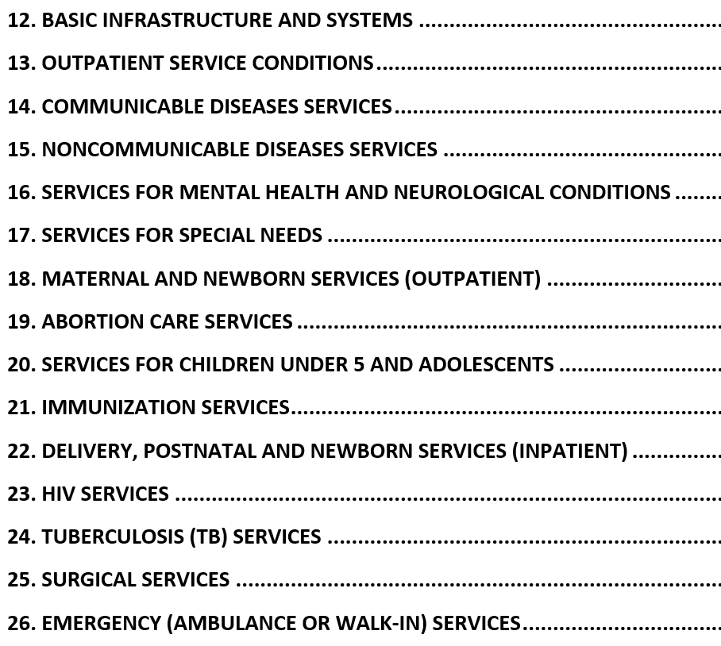
Questionnaire content: Sections
Sections 12–26
Readiness:
programmes and services
Notes:
Most of the sections from Section 12 onwards are related to the Readiness module. ​
​
These sections use a consistent structure in the way information is collected, and we will look at an example later in this unit. ​
​
Sections 12 to 26 relate to programmes or services involving interaction between a health worker and a client, such as:​
​
Section 13 on ‘Outpatient services’;​
Section 15 on ‘Noncommunicable diseases services’;​
Section 21 on ‘Immunization services’; and ​
Section 25 on ‘Surgical services’.

Slide 7
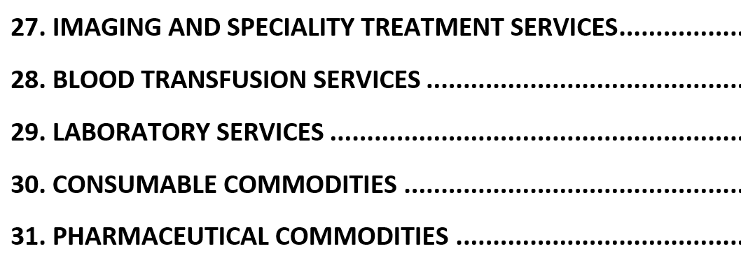
Questionnaire content: Sections
Sections 27–31
Readiness:
support services
Notes:
Sections 27 onwards cover services that support the delivery of the services assessed in the previous sections, such as Section 29 on ‘Laboratory services’, or Section 31 on ‘Pharmaceutical commodities’.

Slide 8
Questionnaire content: Sub-section (example)
18. Outpatient maternal and newborn health services
18.1 Family planning
18.2 Antenatal care
18.3 Prevention of mother-to-child transmission
18.4 Outpatient postnatal care
Notes:
Each section is further subdivided into sub-sections.
For example, Section 18, on Outpatient maternal and newborn health services, is subdivided into 4 sub-sections:
Family planning;
Antenatal care;
Prevention of mother-to-child transmission (or PMTCT); and
Outpatient postnatal care.

Slide 9
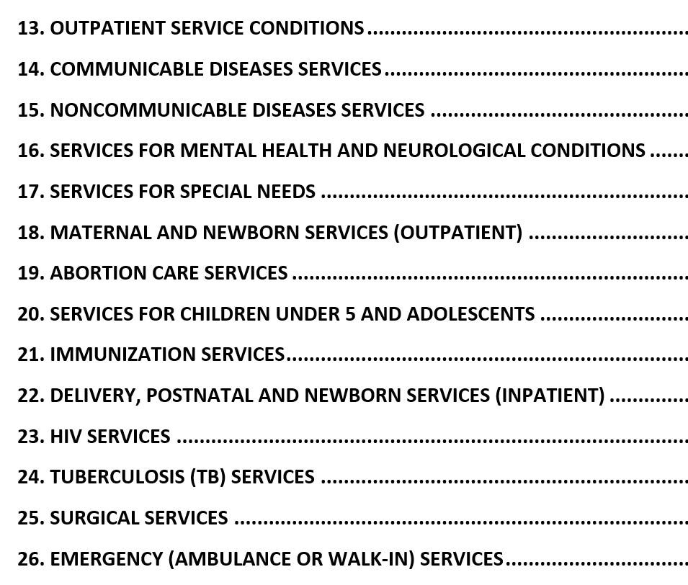
Categories of information: What do the questions ask about?
Sections 13–26
Contain common categories of information:
Service availability
Site conditions
Equipment and commodities
Medicines
The structure of the questionnaire sections and their sub-sections will vary according to the topic being assessed. ​
Support for quality services
Notes:
The structure of the questionnaire sections and their sub-sections will vary according to the topic being assessed. ​
However, in Sections 13 to 26, the sub-sections all contain some or all of the following categories of information:​
Service availability​;
Site conditions​;
Equipment​ and commodities;
Medicines; and
Support for quality services.

Slide 10
Questionnaire content: What do the questions ask about?
18. Outpatient maternal and newborn health services
18.1 Family planning
18.2 Antenatal care
Service availability (availability of ANC services at the facility)
Equipment/commodities (availability and functionality of needed equipment and commodities to provide services)
Support for quality (availability of relevant guideline documents at the site and recent staff training on service provision)
Notes:
Let’s look at sub-section 18.2 – antenatal care. Here, the questions cover information on:​
​
Service availability, related to the availability of ANC services and specific ANC components offered at the facility;​
Equipment/commodities, checking if the equipment and commodities needed to provide those services are available and functioning at the ANC site; and​
Support for quality, checking if the relevant guideline documents are available at the site and if the staff was recently trained to provide the service.

Slide 11
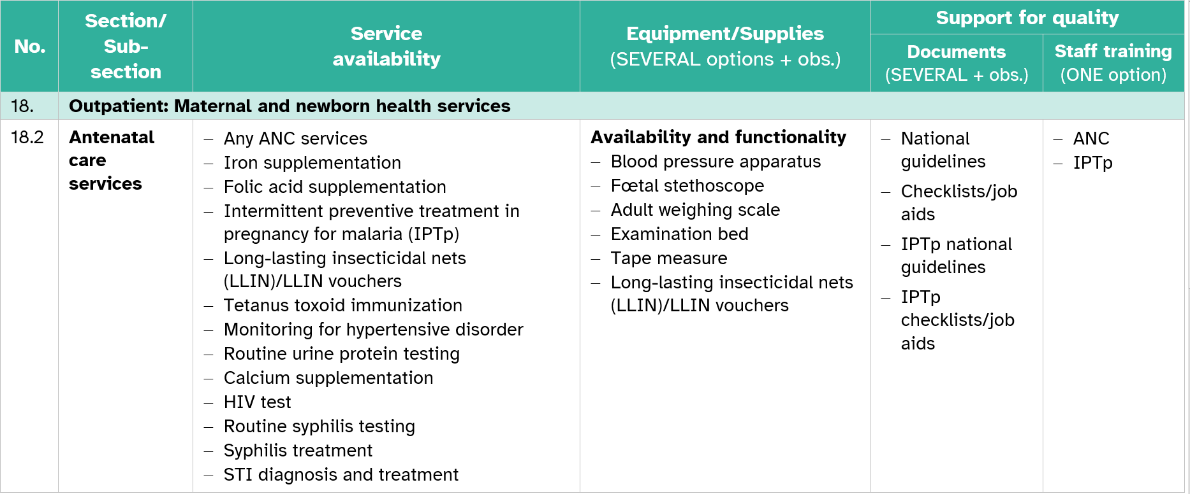
Categories of information: What do the questions ask about?
Notes:
These categories of information can be organized into a summary table that provides a quick overview of the content of the sub-section.​
​
The first and second columns show the questionnaire section and sub-section numbers and names.​
The third column represents the availability of ANC services and specific ANC components available to pregnant women in the facility.​
The fourth column highlights the questions about essential equipment and commodities available in the site, and whether they actually work.​
The final columns illustrate information collected on support for quality, such as:​
the availability of different documents, such as guidelines and job aids; and​
whether the staff received service-related training in the past 2 years.

Slide 12
Questionnaire content: Sub-section (example)
22. Inpatient delivery, postnatal and newborn services
22.1 Delivery care
Service availability
Site conditions
Equipment/commodities
Medicines
Support for quality services
Notes:
We will now look at Sub-section 22.1 on Delivery care, as an example of a sub-section collecting all the categories of information in the readiness sections. ​
​
These categories include: ​
Service availability;​
Site conditions;​
Equipment and commodities; ​
Medicines; and
Support for quality services.

Slide 13
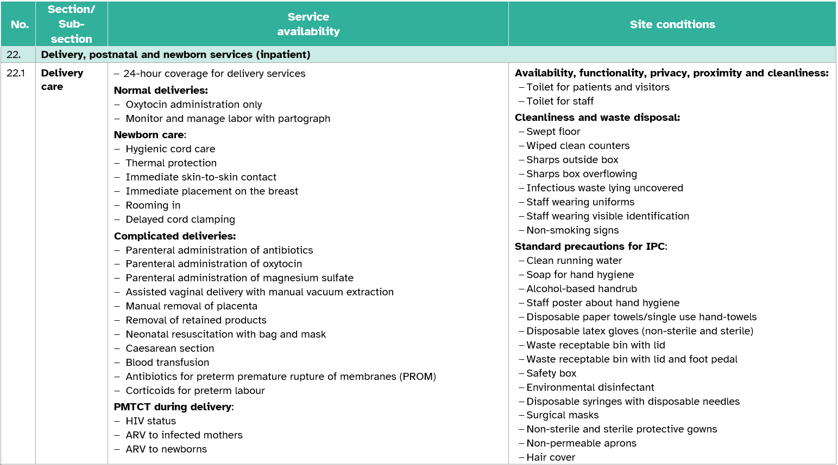
Categories of information: What do the questions ask about?
Notes:
In this case, service availability looks at the different service packages for delivery care, whether there is 24-hour coverage for delivery services, and PMTCT services for women delivering in the facility.​
​
For example, for normal deliveries it is looking at:​
​
oxytocin administration;​
monitoring labour with partograph;​
​
While for newborn care, it looks at:​
hygienic cord care;​
thermal protection;​
immediate skin-to-skin contact;​
immediate placement of the newborn on the breast;​
rooming in; and ​
delayed cord clamping.​

Slide 14
Categories of information: What do the questions ask about?
Notes:
Site conditions for this sub-section is thorough. It collects details about the:​
​
availability and conditions of toilets for patients, visitors and staff;​
the cleanliness and safety at the delivery site; and ​
the standard precautions for infection prevention and control.

Slide 15
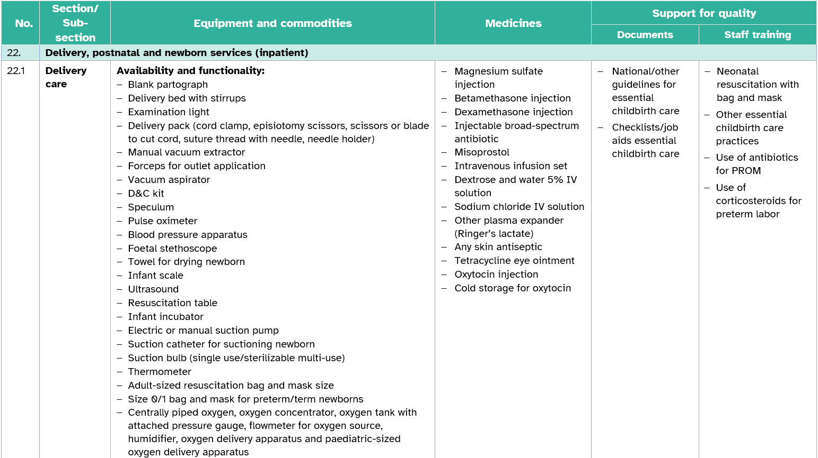
Categories of information: What do the questions ask about?
Notes:
For Equipment and commodities, the questionnaire collects information about availability and functionality of a long list of equipment and commodities for delivery care, including oxygen availability and resuscitation equipment and commodities.
The sub-section also collects information about Medicines that are expected to be present at the site.
Finally, and like other sub-sections, the questionnaire collects information about Support for quality.

Slide 16
Summary
the questionnaire is divided into 31 sections
each section is divided into sub-sections
sub-sections in the readiness modules are most commonly organized around information on Service availability, Site conditions, Equipment and commodities, Medicines, and Support for quality​
the categories of information in the management and finance modules are less standardized
the emphasis on the categories of information varies depending on the particular section/sub-section
Notes:
As a summary, we can say that:
the questionnaire is divided into 31 sections;
each section is divided into sub-sections;
sub-sections in the readiness modules are most commonly organized around information on:
Service availability;
Site conditions;
Equipment and commodities;
Medicines; and
Support for quality.
the categories of information in the management and finance modules are less standardized;
the emphasis on the categories of information varies depending on the particular section or sub-section.

Slide 17
You have now completed Unit 1.
In the next unit, we will look at the questionnaire structure.
First, try the practice exercise.
Notes:
You have now completed Unit 1.
In the next unit, we will look at the questionnaire structure.
First, try the practice exercise.

